Slide 1
Implementing Dijkstra’s Algorithm Using Binary and Binomial Heaps
CO-208 Analysis and Design Algorithm

Slide 2
INTRODUCTION
Dijkstra's algorithm is an algorithm for finding the shortest paths between nodes in a graph.
This algorithm is used in GPS devices to find the shortest path between the current location and the destination.
In this project, we have implemented this algorithm using Binary and Binomial heap on specified or random graph to find a way to minimize the time complexity.
Also able to compare number of operations and time while using Binary and Binomial heap.

Slide 3
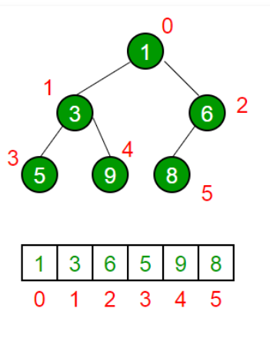
Concept used:
1. BINARY HEAP
A Heap is a special Tree-based data structure in which the tree is a complete binary tree.
A Binary Heap is either Min Heap or Max Heap. In a Min Binary Heap, the key at root must be minimum among all keys present in Binary Heap. The same property must be recursively true for all nodes in Binary Tree.

Slide 4
2. BINOMIAL HEAP
Binomial Heap is an extension of Binary Heap that provides faster union or merge operation together with other operations provided by Binary Heap.
A Binomial Heap is a collection of Binomial Tree where each Binomial Tree follows the Min-Heap property and there can be at most one Binomial Tree of any degree. A Binomial Tree of order k can be constructed by taking two binomial trees of order k-1 and making one as leftmost child or other.
A Binomial Heap with n nodes has the number of Binomial Trees equal to the number of set bits in the binary representation of n. With this relation, we can conclude that there are O(logn) Binomial Trees in a Binomial Heap with ‘n’ nodes.

Slide 5
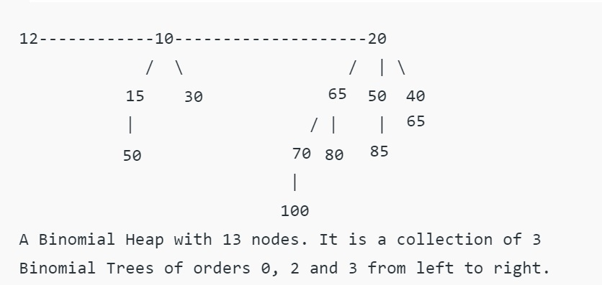
BINOMIAL HEAP REPRESENTATION
For k = 13 Its binary representation will be (00001101)

Slide 6
BINARY HEAP VS BINOMIAL HEAP
Operation | Binary Heap | Binomial Heap
INSERT | O(log N) | O(log N)
FIND-MIN | O(1) | O(log N)
DELETE | O(log N) | O(log N)
DECREASE-KEY | O(log N) | O(log N)
UNION | O(N) | O(log N)

Slide 7
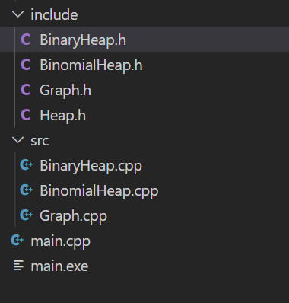
ACTUAL WORK
In this project we made several header files for implementing different heaps and graphs. Successfully, Implemented Dijkstra’s algorithm by binomial heap and binary heap.
These are the header files
These are the source files of header files

Slide 8
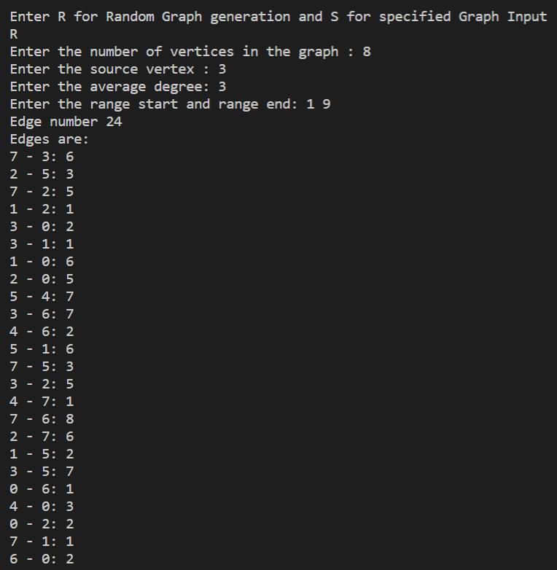
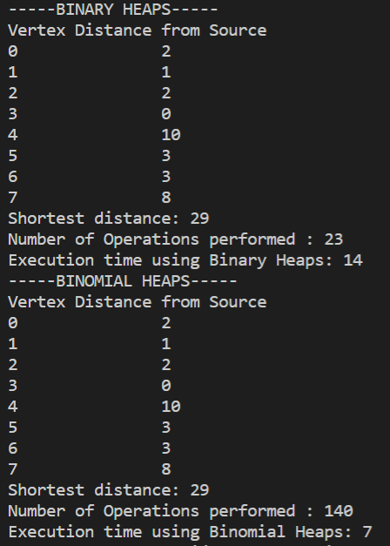
OUTPUT

Slide 9

CONCLUSION
We implemented Dijkstra’s Algorithm using binary and binomial heap data structures, We learned that binomial heap is the extension of binary heap that provides faster union or merge operation together. Results for CPU time had the binomial heap implementation less than or same speed as the binary heap implementation. Moreover, The operations done in binomial heap are greater then binary heap. Through this Project we also learned some new methods of implementing header files.

Slide 10
THANK YOU
SORABH GULIYA (2K20/CO/444)
SUKHDEV CHAUDHARY (2K20/CO/448)

